Slide 1
A Multi-Phase, Flexible, and Accurate Lattice for Pricing Complex Derivatives with Multiple Market Variables

Slide 2
BTT(Bino-trinomial Tree)
A method can reduce nonlinearity error.
The nonlinearity occurs at certain critical locations such as a certain point, a price level, or a time point.
Pricing results converge smoothly and quickly.
A BTT is combined a more bBTT(basic BTT)

Slide 3
bBTT(Basic Bino-trinomial Tree)
The bBTT is essentially a binomial tree except for a trinomial structure at the first time step.
There is a truncated CRR tree at the second time step to maturity.
Which provides the needed flexibility to deal with critical locations.

Slide 4
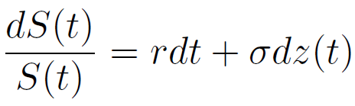
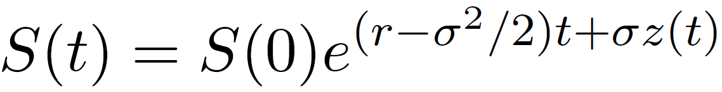
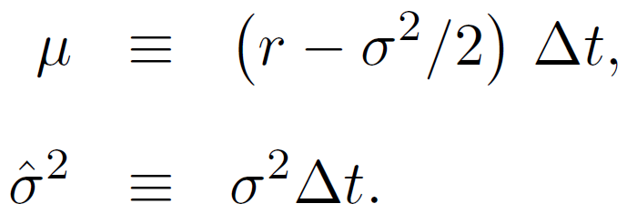
Basic Terms
The stock price follow a lognormal diffusion process:
=>
The mean and variance of the lognormal return of :
The CRR(Cox, Ross, & Rubinstein) lattice adopts:

Slide 5
Log-distance
Define the log-distance between stock price
and as .
The log-distance between any two adjacent stock price at any time step in the CRR lattice is .

Slide 6
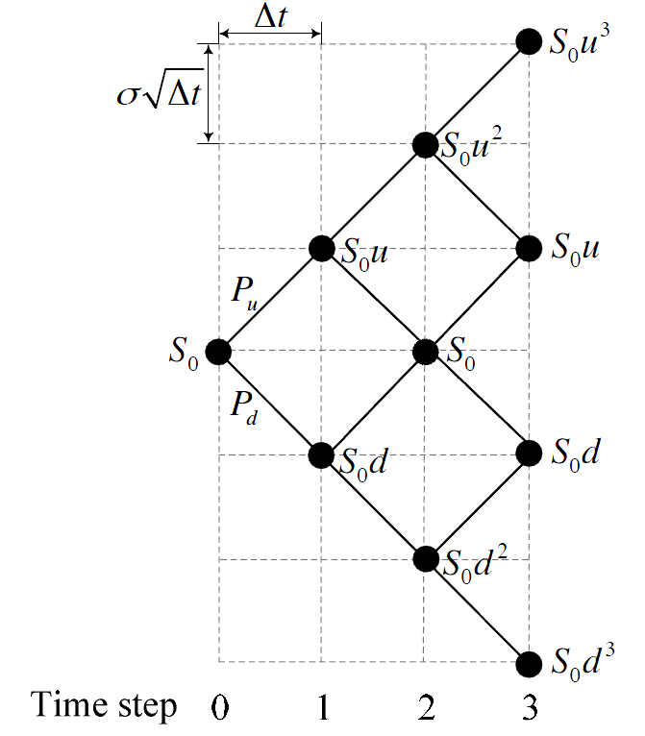
CRR tree

Slide 7
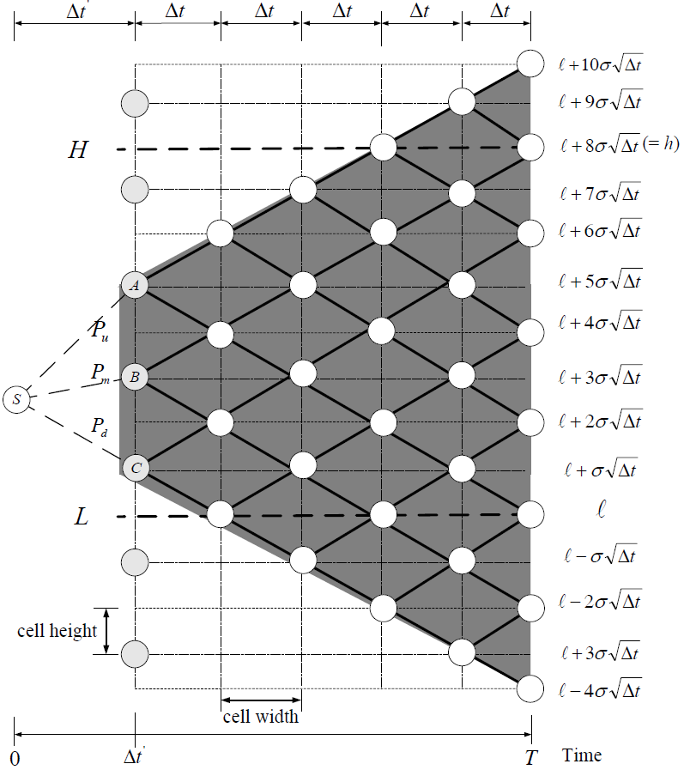
bBTT

Slide 8
bBTT
Coincide the lattices and the barriers.
Let
Adjust s.t to be an integer.
The first time interval

Slide 9
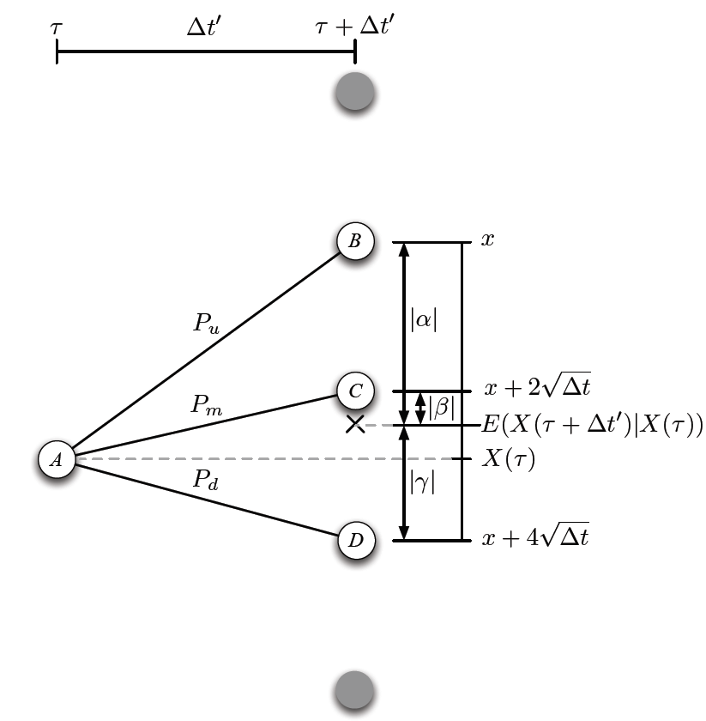
The probability of the lattices at first step time

Slide 10
The probability of the lattices at first step time
Define to be the mean of stock prices at time .
Define the node which is most closely to
to .
Define

Slide 11
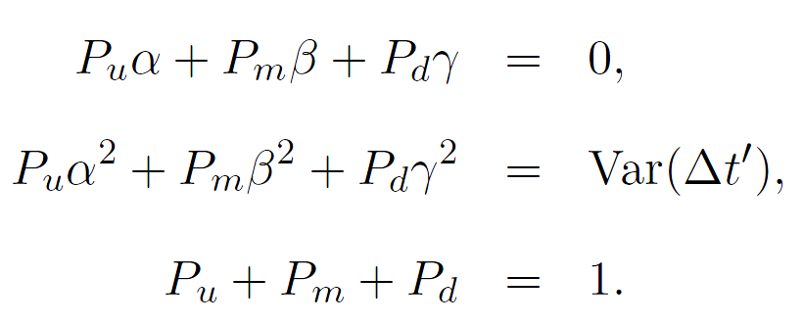
The probability of the lattices at first step time
The branching probabilities of node A
can be derived by solving the equalities:

Slide 12
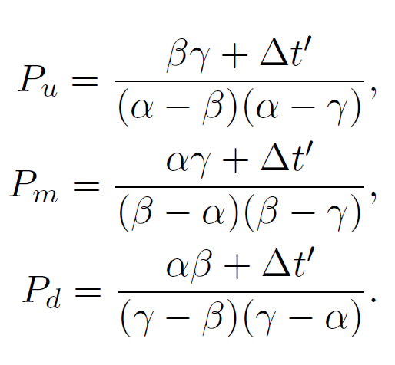
The probability of the lattices at first step time
By Cramer’s rule, we solve it as

Slide 13
Transform correlated processes to uncorrelated
Use the orthogonalization to transform a set of correlated process to uncorrelated.
Construct a lattice for the first uncorrelated process which match the first coordinate.
Then construct the second uncorrelated process on the first lattice to form a bivariate lattice which match the second coordinate.
For general, the i-th uncorrelated process on top of the (i-1)-variate lattice constructed an i-variate lattice. The i-th lattice match the i-th coordinate.

Slide 14
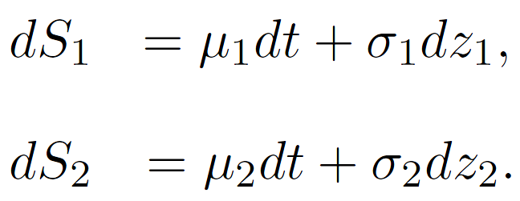
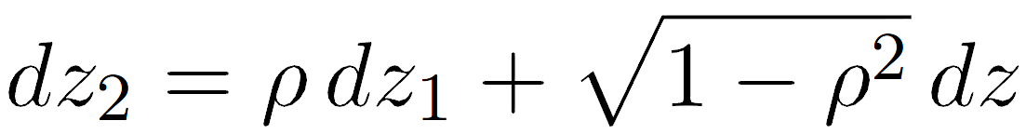
Transform correlated processes to uncorrelated
Demonstrate for 2 correlated processes.
Let and follow:
can be decomposed into a linear combination of and another independent Brownian motion :

Slide 15
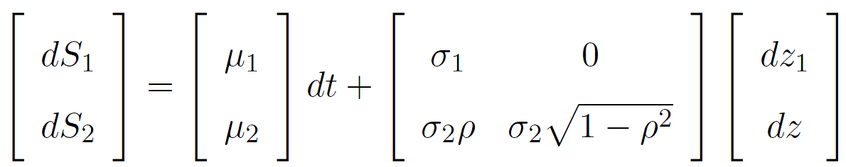
Transform correlated processes to uncorrelated
The matrix form:
Define =>

Slide 16
Transform correlated processes to uncorrelated
Transform and into two uncorrelated processes and .
The matrix form:

Slide 17
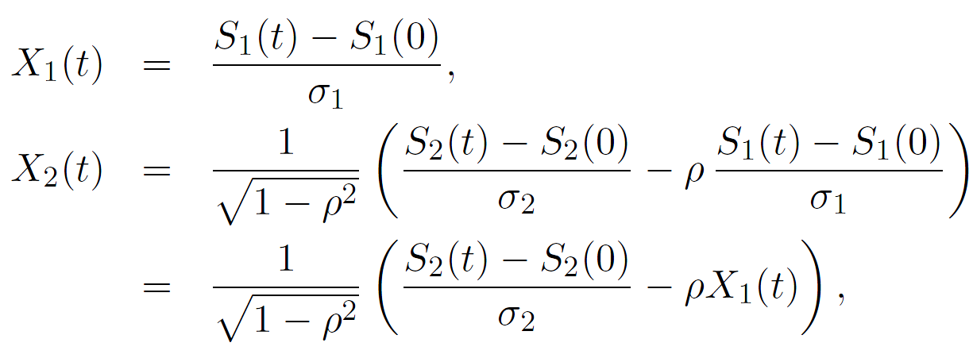
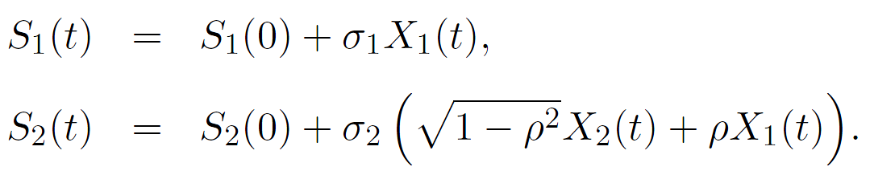
Transform correlated processes to uncorrelated
Integrate both sides:
Then and can be expressed in terms of
and :

Slide 18
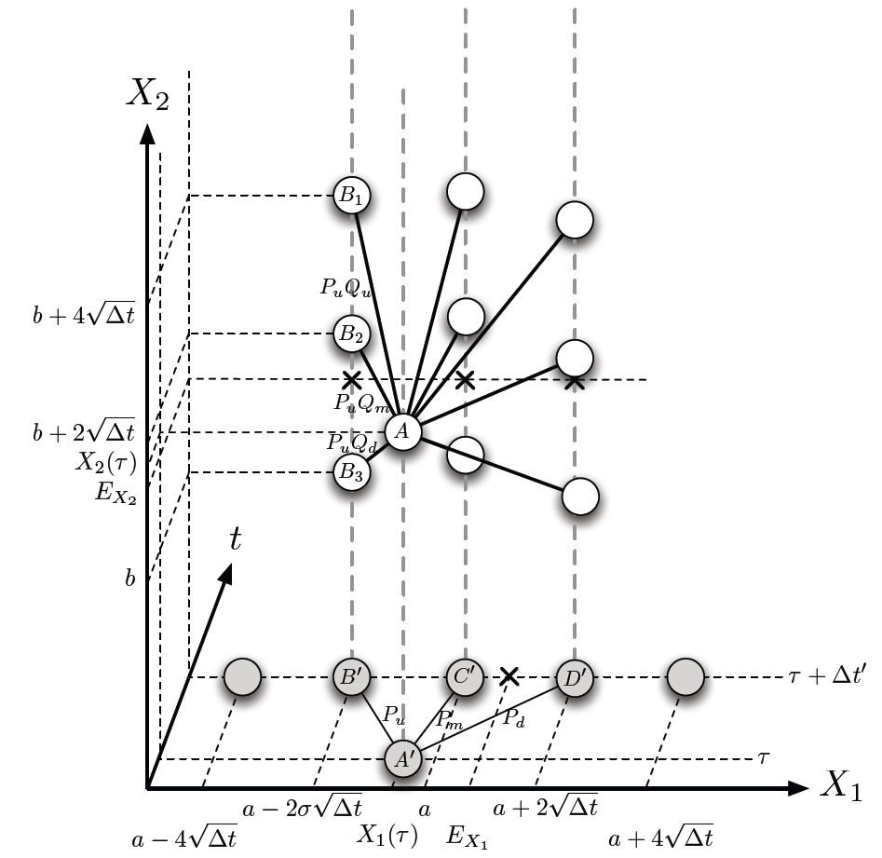
Multi-phase branch construction

Slide 19
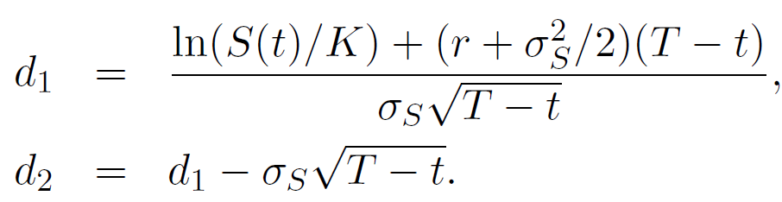
A bivariate lattice: two correlated market variables
Define is the stock price, is the firm’s asset value.
The bivariate lattice is built to price vulnerable barrier options with the strike price and the barrier .
The default boundary for the firm's asset value
where

Slide 20
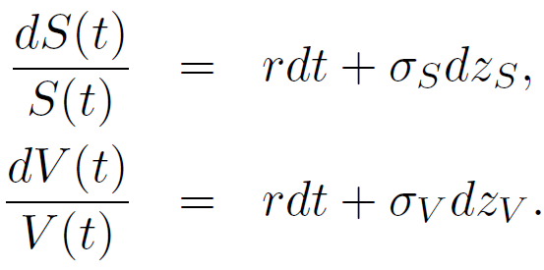
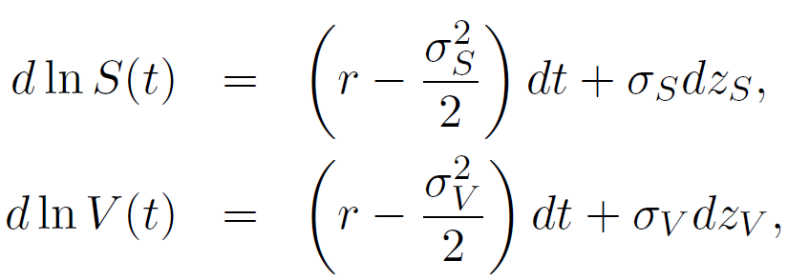
A bivariate lattice: two correlated market variables
Assume and follow the processes:
By Ito’s lemma:

Slide 21
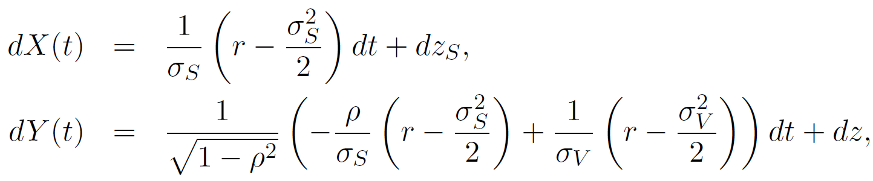
A bivariate lattice: two correlated market variables
Use the orthogonalization:
=>

Slide 22
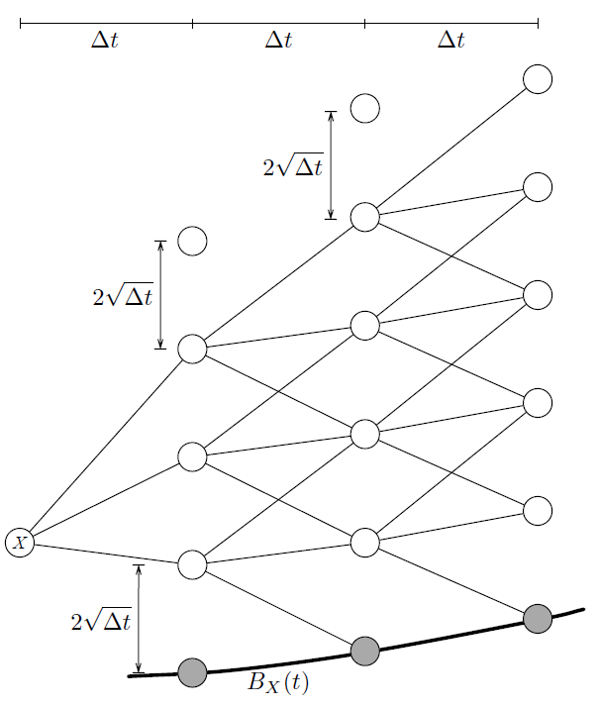
Transform to

Slide 23
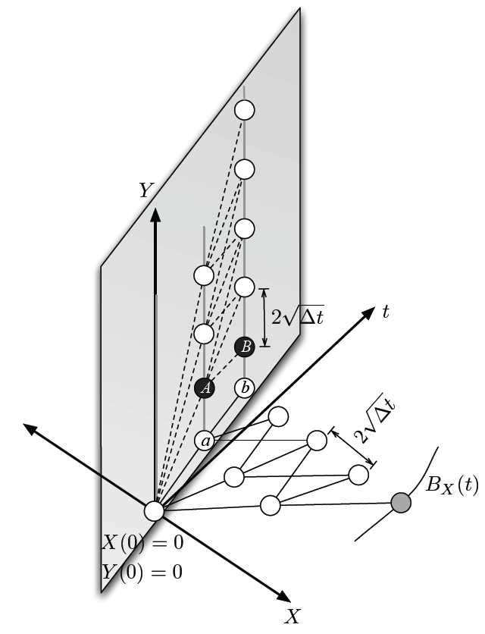
Transform to

Slide 24
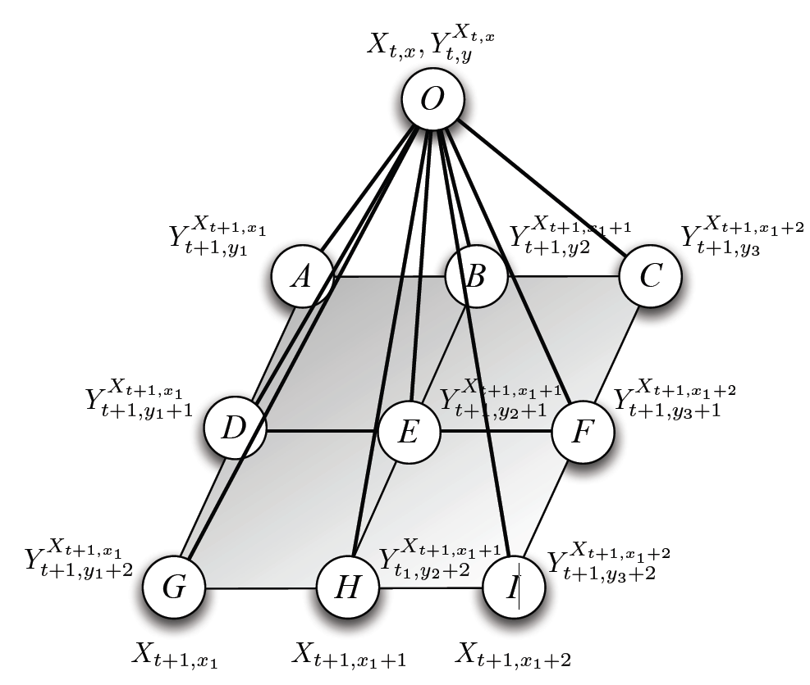
The branches

Slide 25
An example lattice
Assumption:

Slide 26
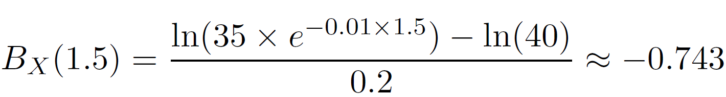
An example lattice
Set the option for 2 periods ( ).
Compute the lattices in X coordinate first.
For example,
The log-distance between 2 vertically adjacent nodes is

Slide 27
An example lattice
Similar,

Slide 28
An example lattice
Then compute the lattices in Y coordinate.
For example,

Slide 29
An example lattice
Similar,

Slide 30
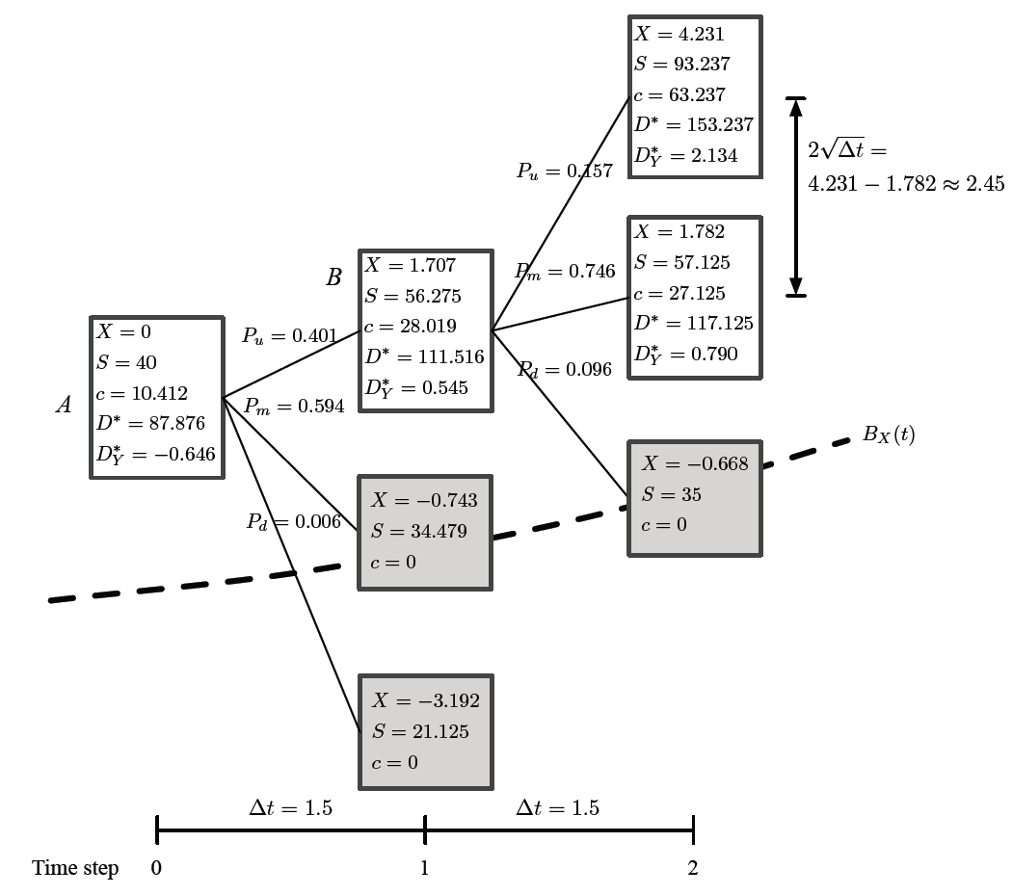
An example lattice

Slide 31
An example lattice
Plot the 3D coordinate by X, Y, and t.
Find , , and for the same method, which
Compute the option value at each node.
Find the initial option value by backward induction.

Slide 32
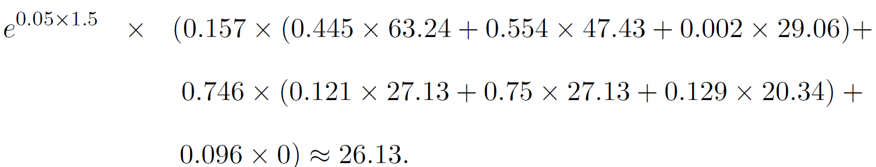
An example lattice
For node C,
For node D,
Then the call value at node B:
By backward induction, the initial value=7.34

Slide 33
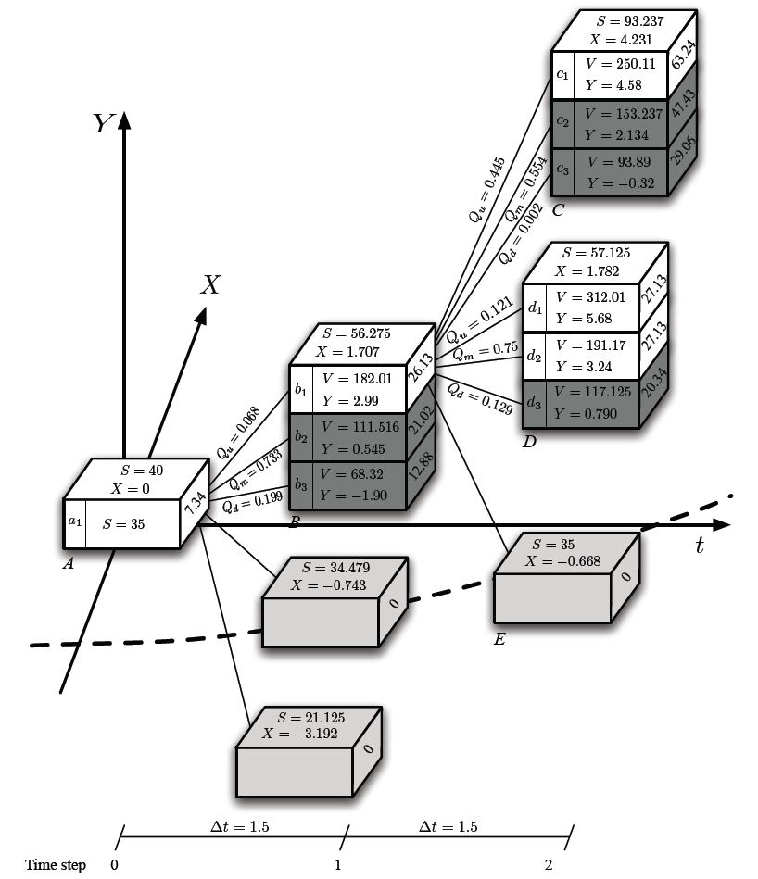
An example lattice

Slide 34
The Hull-While interest rate model
The short rate at time t, r(t) follows
is a function of time that make the model fit the real-world interest rate market.
denotes the mean reversion rate for the short rate to revert to .
denotes the instantaneous volatility of the short rate.
is the standard Brownian motion.

Slide 35
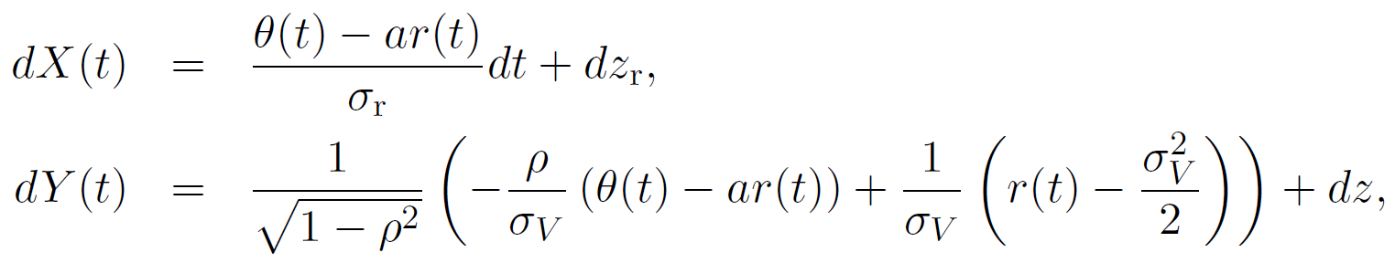
A bivariate lattice with stochastic interest rate as the second market variable
is the interest rate, is the firm’s value.
The default boundary under the Hull-While interest rate model is ,
The stochastic process:

